Slide 1
BIA 650 – Process Optimization and Analytics
2. Linear Programming
    Applications of LP
    Assumptions
    Algebraic Representation
      LP terminology
    Graphic Representation
      Infeasibility, unboundedness
    Spreadsheet Representation
    Sensitivity Analysis
© E. A. Stohr, 2018

Slide 2
Optimization Applications
In a typical optimization problem, the levels of the decision variables (activities) must be decided to obtain optimal performance subject to constraints. Applications include the following:
Production planning
Blending mix
Transportation and logistics
Facility location
Portfolio optimization
Capital budgeting
Cash flow management
Advertising placement
Refinery management
Supply chain management
Linear Programming (LP) is the most widely used optimization technique because it applies to a broad range of problems and can be solved efficiently. LP occurs when the objective function is linear and the constraints can be expressed as linear inequalities.

Slide 3
Algebraic Representation
Diet Problem Example (blending mix)
Minimize the cost of a diet consisting of a blend of different food types that meets minimum daily nutrition requirements.
Data: meat costs $10 per pound and provides 10 units of protein & 4 units of iron;
cereal costs $2 per pound and provides 5 units of protein & 4 units of iron
The diet must provide at least 20 units of protein and 10 units of iron.
REPRESENTATION:
Decision Variables: M lbs of meat in diet, C lbs of cereal
Objective function: Min 10.M + 2.C
Constraints: 10.M + 5.C > 20 (protein)
4.M + 4.C > 10 (iron)
Non-negativity: M > 0 and C > 0
20 and 10 are RHS (right-hand-side) constants

Slide 4
Assumptions of LP
Proportionality
The objective function and every constraint must be linear
i.e., the marginal measure of effectiveness and the marginal usage of each resource is always the same in the region of interest. (no decreasing or increasing returns to scale and no setup costs for activities.) If these marginal values vary, we have a non-linear programming problem. For example, the objective function may best be represented by a quadratic function.
Additivity
Profit = p₁.x₁ + p₂.x₂ is additive
But what if the marginal profitability of x₁ interacts with that of x₂?
Divisibility
Fractional values of variables must be possible. If the decision variables must be integers to make sense (e.g. x₁ = 1 represents the decision to place a factory at location L) and x₁ = 0 means that no factory is placed at L, then we have a (much harder) integer programming problem.)
Deterministic
All of the coefficients must be constants. No randomness. If the coefficients are best represented by random variables we have a stochastic programming problem.

Slide 5
Canonical Form of an LP
Any general LP (i.e. one with a mixture of < , >, = constraints) can be expressed in the canonical form:
_{n}
Max Σ c_{j}x_{j}
¹
Subject to:
_{n}
Σ a_{ij}x_{j} < b_{i} for i = 1,2, …,m
¹
x_{j} > 0 for j = 1,2, … ,n
(Likewise, any LP can be expressed in a minimization form with > constraints.)
In matrix notation the canonical form is:
Max c^{t} x (x is a column vector, c^{t (}the transform of column vector c)
is a row vector)
subject to
A x < b, x > 0 (A is an m x n matrix of coefficients, b is the RHS
column vector)

Slide 6
Transformations of Inequalities
Changing the direction of optimization
Max c^{t}.X is the same as Min (-c^{t}).X
Changing the sense of an inequality
_{j=1}^{n}∑a_{ij}.x_{ij} < b_{i} for i = 1,2 .. M is the same as
_{j=1}^{n}∑(-a_{ij}).x_{ij} > - b_{i} for i = 1,2 .. M
Converting equalities to inequalities
_{j=1}^{n}∑a_{ij}.x_{ij} = b_{i} for i = 1,2 .. M is the same as
_{j=1}^{n}∑a_{ij}.x_{ij} < b_{i} for i = 1,2 .. M and _{j=1}^{n}∑a_{ij}.x_{ij} > b_{i} for i = 1,2 .. M
Converting inequalities to equalities
_{j=1}^{n}∑a_{j}.x_{j} < b can be written as _{j=1}^{n}∑a_{j}.x_{j} + s = b
_{j=1}^{n}∑a_{j}.x_{j} > b can be written as _{j=1}^{n}∑a_{j}.x_{j} - t = b
where s is a “slack” variable and t is a “surplus” variable
Converting variable x_{j} unconstrained in sign to non-negative variables.
Add additional non-negative variables x_{j}’> 0 and x_{j}’’> 0 by defining:
x_{j} = x_{j}’ - x_{j}’’

Slide 7
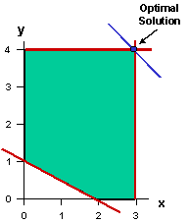
Graphical Solutions - 1
Source: http://fisher.osu.edu/~croxton_4/tutorial/
  Maximize: x+y
  Subject to:
  x + 2 y > 2
  x < 3
  y < 4
  x > 0, y > 0
x + y =3
x + 2y > 2
The optimal solution lies on two “binding” constraints.
The constraint x + 2y > 2 is “non-binding”.
At the optimal solution, x + y = 3 + 4 = 7.
The “surplus” of the X + 2Y > 2 constraint then is 11-2 = 9.

Slide 8
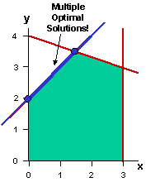
Graphical Solutions - 2
x - y
  Minimize: x – y
  Subject to:
  1/3 x + y < 4
  -2 x + 2 y < 4
  x < 3
  x > 0, y > 0
Note: This is easier seen as solving the same problem with an objective: Max Y – X.

Slide 9
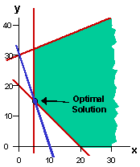
Graphical Solutions - 3
  Minimize: x + 1/3 y
  Subject to:
  x + y > 20
  -2 x + 5 y < 150
  x > 5
  x > 0 y > 0
If the problem was to maximize the objective function, we would have an unbounded solution.

Slide 10
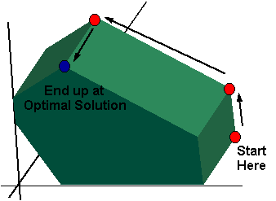
Simplex Method
Moves from a starting feasible extreme point to another feasible extreme point so that the value of the objective function is improved (increased for a maximization problem or decreased for a minimization problem) at each step.

Slide 11
Linear Programming Terms
If an optimal solution exists, it is at a corner point of the feasible region. Corner points are also called "extreme points" or "basic feasible solutions".
An LP may:
Have an optimal solution
Have multiple optimal solutions
Be infeasible
Be unbounded
Example of a pair of infeasible constraints
x + y >= 4 and x + y <= 3.
We can't satisfy both of these constraints at once.

Slide 12
Graphical Solution (In-class)
Max Z = 3X1 + 5X2
X1 < 4
X2 < 6
3X1 + 2X2 < 18
X1 > 0, X2 > 0
X2
X1

Slide 13
Graphical Solution (In-class)
X2
Optimal Solution
X1*=2, X2*=6
Z= 36
Max Z = 3X1 + 5X2
X1 < 4
X2 < 6
3X1 + 2X2 < 18
X1 > 0, X2 > 0
Z=15
X1

Slide 14
Spreadsheet Representation
Formulating LPs in a spreadsheet is much more transparent.
One can use all of the normal formulae, computational, and display functionality in Excel to help represent the problem mathematically and at the same time document it for others.
The built-in Solver in Excel is extremely powerful and versatile.
The SolverTable add-in that comes with the W&A CD facilitates sensitivity analysis.
However, large LP problems cannot be solved using Excel’s Solver. For large problems we will us C-Plex software later in the course.

Slide 15
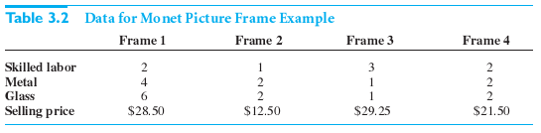
Example 3.2 from W&A 3rd edition
The Monet Company produces four types of picture frames, which we label 1, 2, 3, 4.
The four types of frames differ with respect to size, shape and materials used.
Each type requires a certain amount of skilled labor, metal, and glass as shown in this table. The table lists the unit selling price Monet charges for each type of frame.
Winston/Albright
Practical Management Science,

Slide 16
Example 3.2 (continued)
During the coming week Monet can purchase up to 4000 hours of skilled labor, 6000 ounces of metal, and 10,000 ounces of glass.
The unit costs are $8.00 per labor hour, $0.50 per ounce of metal, and $0.75 per ounce of glass.
Also, market constraints are such that it is impossible to sell more than 1000 type 1 frames, 2000 type 2, frames, 500 type 3 frames, and 1000 type 4 frames.
The company wants to maximize its weekly profit.
In this problem, the decision variables are the number of frames of type 1, 2, 3, and 4 to produce. We label these x₁, x₂, x₃, x₄.

Slide 17
Algebraic Formulation of Ex 3.2
Maximize 6x₁ + 2x₂ + 4x₃ + 3x₄ (profit objective)
Subject to 2x₁ + x₂ + 3x₃ + 2x₄ ≤ 4000 (labor constraint)
4x₁ + 2x₂ + x₃ + 2x₄ ≤ 6,000 (metal constraint)
6x₁ + 2x₂ + x₃ + 2x₄ ≤ 10,000 (glass constraint)
x₁ ≤ 1000 (frame 1 sales constraints)
x₂ ≤ 2000 (frame 2 sales constraints)
x₃ ≤ 500 (frame 3 sales constraints)
x₄ ≤ 1000 (frame 4 sales constraints)
x₁, x₂, x₃, x₄ ≥ 0 (non-negativity constraint)
How are the objective coefficients in the above calculated? What do they represent?
Hint. The coefficient of x₁ = 28.5-2x8-4x0.5-6x0.75 = 6

Slide 18
Spreadsheet Formulation of Ex 3.2
Product mix model | Example W&A Ch 3, #2 |  |  |  |  | Range names used
 |  |  |  |  |  | Frames_produced | =Model!$B$16:$E$16
Input data |  |  |  |  |  | Maximum_sales | =Model!$B$18:$E$18
Hourly wage rate | $8.00 |  |  |  |  | Profit | =Model!$F$32
Cost per oz of metal | $0.50 |  |  |  |  | Resources_available | =Model!$D$21:$D$23
Cost per oz of glass | $0.75 |  |  |  |  | Resources_used | =Model!$B$21:$B$23
Frame type | 1 | 2 | 3 | 4
Labor hours per frame | 2 | 1 | 3 | 2
Metal (oz.) per frame | 4 | 2 | 1 | 2
Glass (oz.) per frame | 6 | 2 | 1 | 2
Unit selling price | $28.50 | $12.50 | $29.25 | $21.50
Production plan
Frame type | 1 | 2 | 3 | 4
Frames produced | 1000 | 800 | 400 | 0
 | <= | <= | <= | <=
Maximum sales | 1000 | 2000 | 500 | 1000
Resource constraints | Resources used |  | Resources available
Labor hours | 4000 | <= | 4000
Metal (oz.) | 6000 | <= | 6000
Glass (oz.) | 8000 | <= | 10000
Revenue, cost summary
Frame type | 1 | 2 | 3 | 4 | Totals
Revenue | $28,500 | $10,000 | $11,700 | $0 | $50,200
Costs of inputs
Labor | $16,000 | $6,400 | $9,600 | $0 | $32,000
Metal | $2,000 | $800 | $200 | $0 | $3,000
Glass | $4,500 | $1,200 | $300 | $0 | $6,000
Profit | $6,000 | $1,600 | $1,600 | $0 | $9,200
After running solver we get the optimal result shown here
“Accounting” variables not essential to the model
Maximize this cell

Slide 19
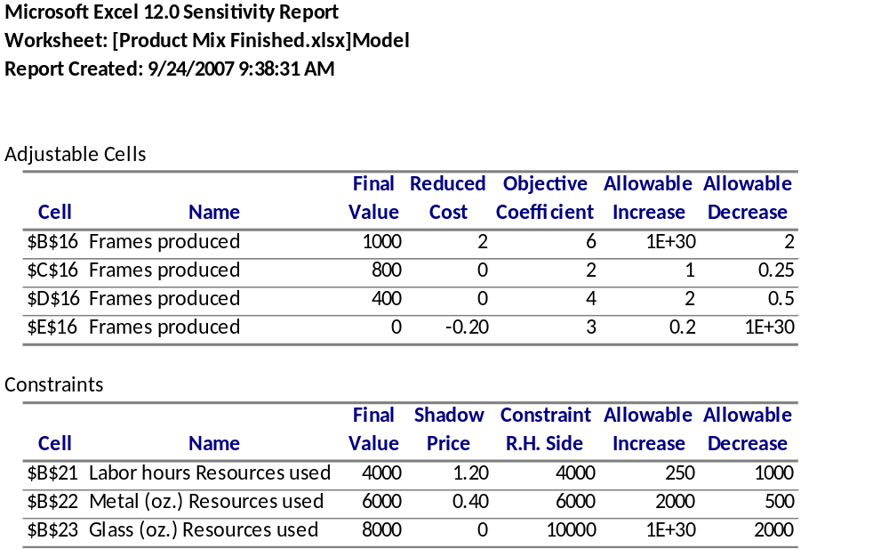
Solver Sensitivity Analysis - 1
Reduced Cost: Amount by which an objective function coefficient must change in order for the corresponding variable to enter the solution or for a variable at its upper bound to decrease from its upper bound.
Shadow Price: Improvement in value of objective function associated with loosening the restriction imposed by a constraint by one unit.

Slide 20
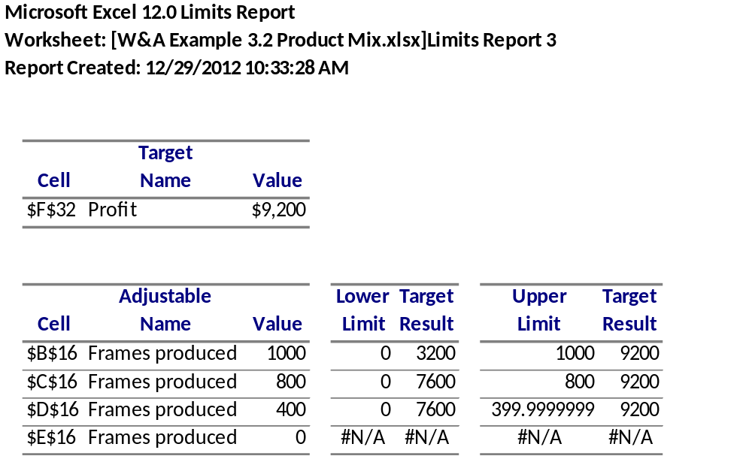
Solver Sensitivity Analysis - 2
The Limits Report is created by re-running the Solver model with each decision variable in turn as the objective (both maximizing and minimizing), and all other variables held fixed. Hence, it shows a “lower limit” for each variable, which is the smallest value that a variable can take while satisfying the constraints and holding all of the other variables constant, and an “upper limit,” which is the largest value the variable can take under these circumstances.
This form of sensitivity analysis is not used much

Slide 21
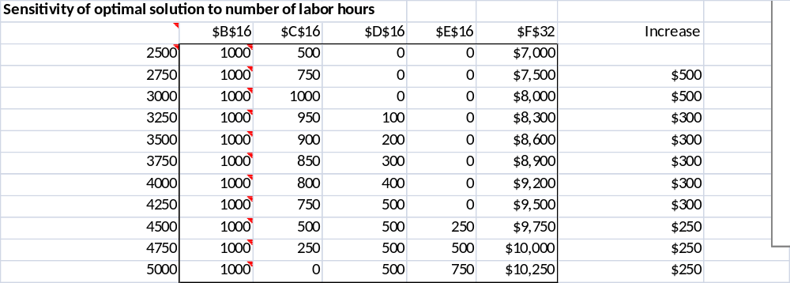
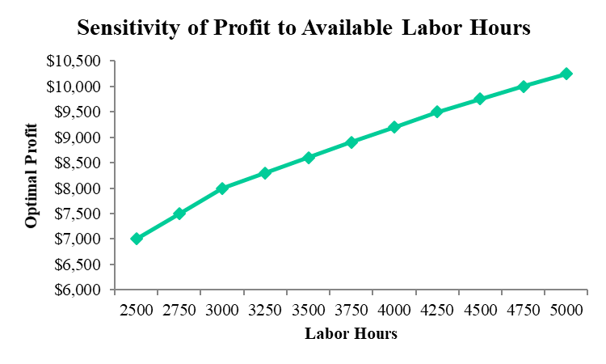
Solver Table Sensitivity Analysis
Profit
Obtain solver table from CD or Cengage web site. For MAC may need to installVM

